Slide 1
ABDA: Assignment 7
2020-01-21

Slide 2
Model structure
transformed data {
vector[N_data] log_reaction_time = log(reaction_time);
}
parameters {
// Group level
vector[2] mu;
vector<lower = 0>[2] tau;
vector[2] phi;
// Individual level
vector[N_subjects] theta[2];
real<lower = 0> sigma;
}
model {
for (i in 1:N_data) {
log_reaction_time[i] ~ normal(theta[1][subjects[i]] + theta[2][subjects[i]] * attempts[i] , sigma);
}
for (i in 1:N_subjects) {
theta[1][i] ~ normal(mu[1] + phi[1]*is_child[i], tau[1]);
theta[2][i] ~ normal(mu[2] + phi[2]*is_child[i], tau[2]);
}
}

Slide 3
Question 1: Give an interpretation of theta0 and theta1 in plain text. Explain to a non-statistician what these two parameters mean.
In standard scale:
theta0 is the mean estimate for the starting reaction time for each individual
theta1 is the mean estimate for the learning rate/attempt

Slide 4
Question 2: Give an interpretation of all the phi:s and mu:s in plain text. Explain to a non-statistician what these parameters mean. Try to do it in the original scale, i.e. in terms of average reaction time rather than log reaction time.
mu0 is the starting reaction time mean estimate for an adult
phi0 is the difference in starting reaction time mean estimate between a child and an adult
mu1 is the learning rate mean estimate for an adult
phi1 is the difference in learning rate mean estimate between a child and an adult

Slide 5
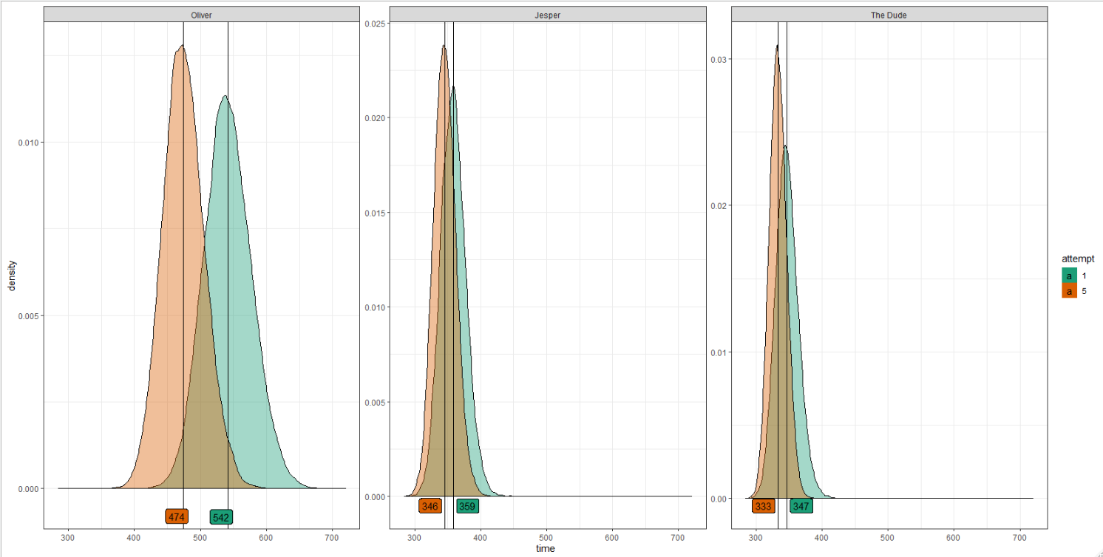
Question 3: Provide the expected reaction time for the first attempt (x=1) and the fifth attempt (x=5) for the first individual (Oliver), third individual (Jesper) and fourth individual (“the dude”), i.e. individuals j = 0,2,3 in python or j=1,3,4 in julia/matlab. See my (soon to come) results below if you get similar results.

Slide 6
Question 4: Discuss possible model improvements to our model.
What would happen if x goes to infinity? Is this physically realistic? It seems like there is no way to get a reaction time less than 100ms looking at the website and our data.
How can we improve the model?
Should we change distributions (likelihood, priors)? What options do we have and why?
The expected reaction time with infinite attempts would be negative, which is not realistic.
Naïve improvement would be to model the learning as an exponential decay plateauing off on a realistic bottom(ex. 100ms)

Slide 7
Question 5: Notice that your sigma has decreased in Assignment 7, but are the same in 6 and 5. Why is that do you think?

